Slide 1
SGRE | DevSecOps Next Steps - Testing
May 2025

Slide 2









SGRE – DevSecOps Next Steps - Outlook
1- Roles and responsibilities
2- Test environment provisioning
DevOps pipeline
SUT: System Under Test
3- Integration Test Strategy
Systematic test design
Test automation
Acceptance test, User-Workflows
4- Qualities & Risks
NFR: security, performance,..(FURPS)
RBT: Risk Based Testing
Requirement Engineering
5- Traceability & Dashboard
Quality Gates & KPIs for testing
Dashboards → Test Mgmt Tool
Roles & Responsibilities
Test environment provisioning
Traceability & Dashboards
Integration Test Strategy
Qualities & Risks

Slide 3
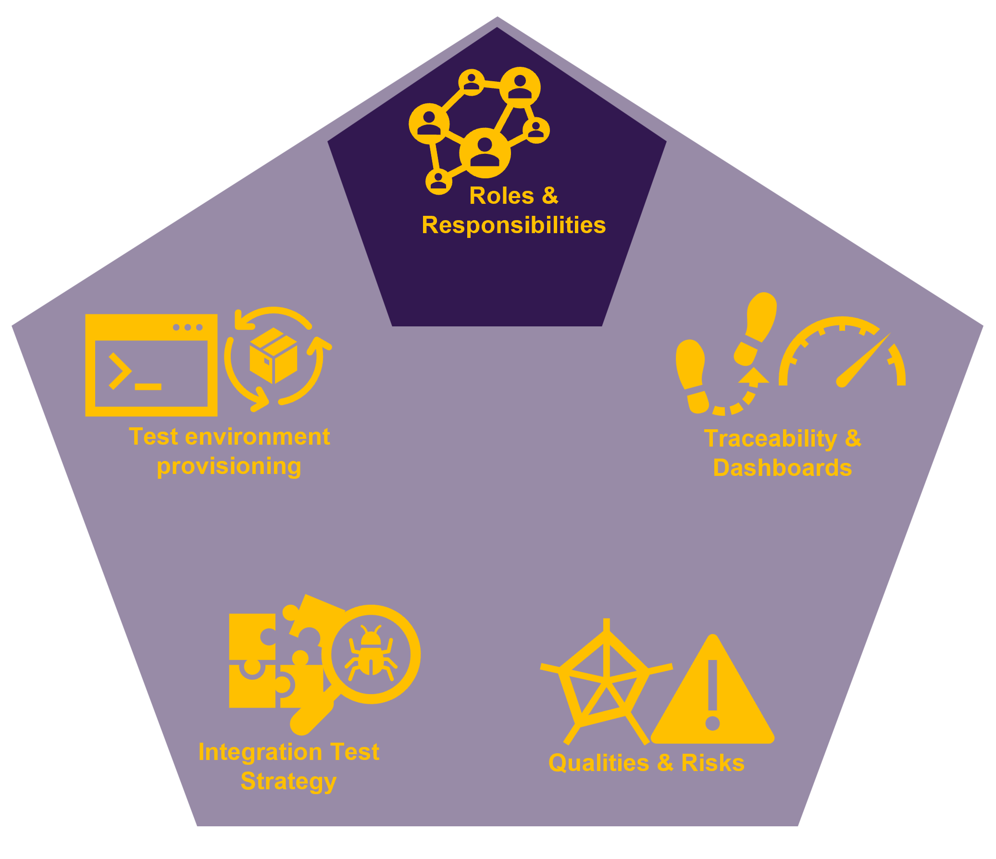




Next Steps - Testing Roles & responsibilities… governance and empowerment are crucial
Leadership
Value environment and infrastructure as product software
DevOps and Testing experts on Enterprise Architecture level required.
Setup DevOps Enablement Team with clear responsibilities across all ARTs. The team must be empowered to roll out all patterns and concepts towards the team.
Reorganize testing team. Redefine the responsibilities of SOL-ST.
Leverage development efficiency metrics to constantly track progress and changes e.g., DORA-Metrics
Ops Team (BU Teams)
ART Teams
Teams
ART Teams
DevOps
Enablement Team
Define the responsibility for quality delivery within the ART Teams
Setup dedicated enablement team (~5 FTEs for MySite360)
Responsible for environments and pipeline framework
Interface to operations team (BU) to building trust
Full time to cover all aspects not just pSites
Establish the role of DevOps/Test Engineer per ART team
Interface to enablement team
Know-how transfer into ART teams
Responsible for team pipelines and green2green approach
Test
Enablement Team
[Test Architects]
ART Teams

Slide 4
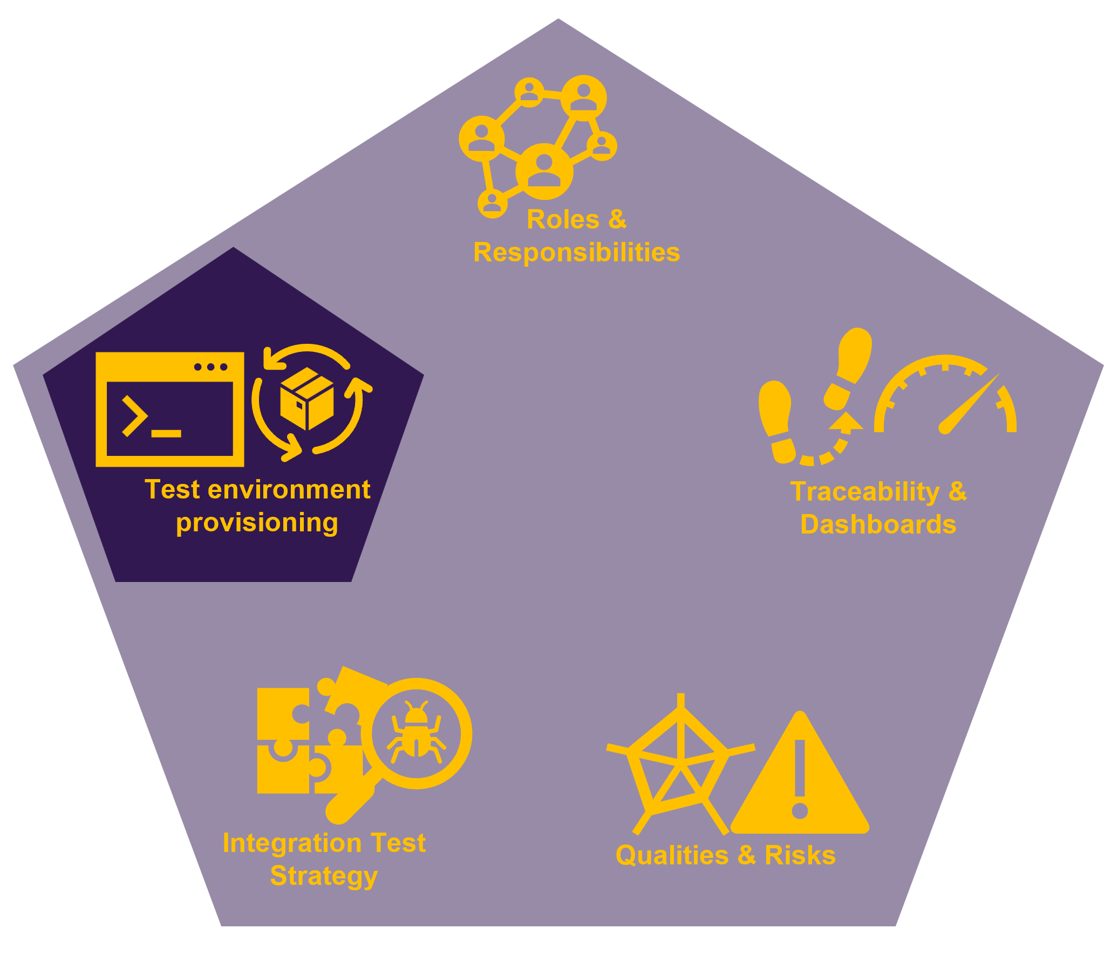
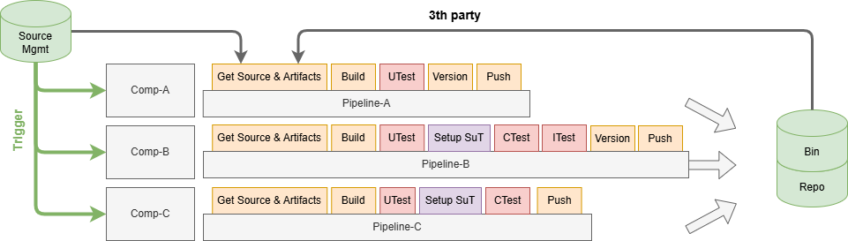
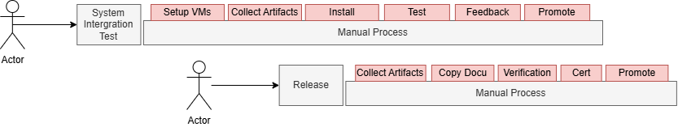
Next Steps - Testing Test environment provisioning … how it looks today
Just happens once every release cycle after “code freeze”. In worst case developer getting feedback from the testing team after more than 3 month!
pSites
As-Is
Each team using their own component pipelines with very different maturity levels. No harmonization at all.
The level of automated testing depends heavily on the dependencies towards other components. E.g. ART-A have less dependencies and created their own infrastructure to enable the development teams to do advanced testing. ART-E is tested decoupled.
Current System/Integration-Testing is decoupled from the actional development teams and basically one PI cycle behind implementation. This leads to very late feedback.
Release complete is reached without evidence. Dev teams “say” is ready. Nobody knows if different components fit together.

Slide 5
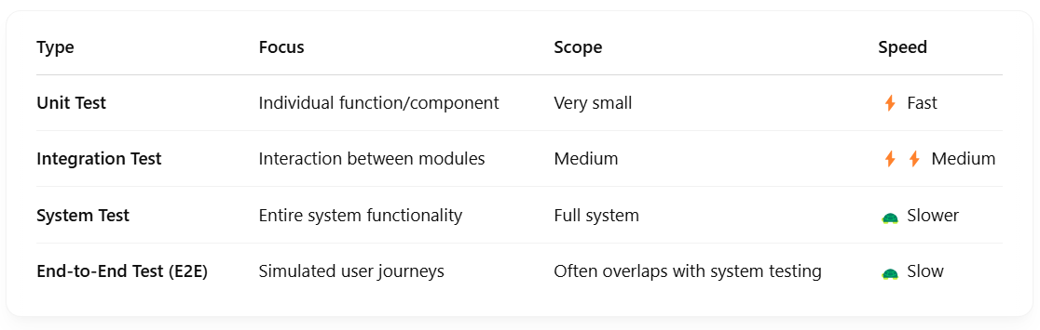
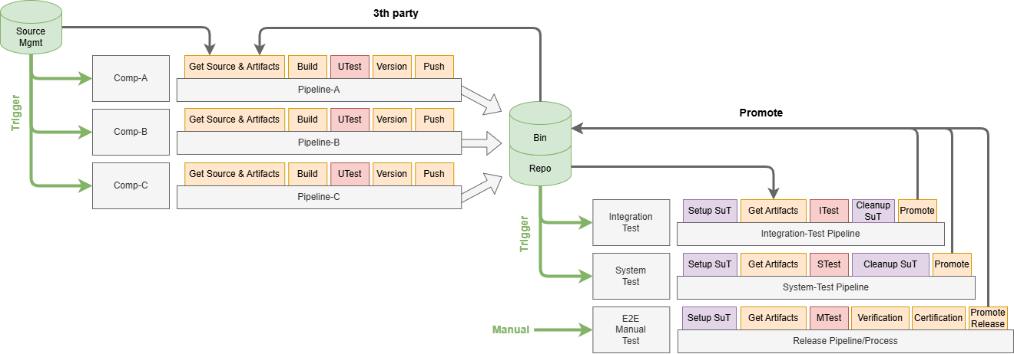

Next Steps - Testing Test environment provisioning … fully automated test execution is key
Important
vSites
The current detailed realization focusing on stop the bleeding and uses existing MySite360 tooling.
The three focus points are:
Shift-Left: Early test execution to reduce number of finding in later “time-consuming” stages. A novel system integration strategy needs to be defined and planned, which supports earlier testing.
Fast-Feedback: Provide feedback to developers as fast as possible.
Automation: high automation rate is key and includes automated provisioning of test environments.
*After the test environment is (automatically) provided, manual testing is still required as an intermediate step, during the transition to higher test-automation.
Test architecture for organizing test tool landscape (own frameworks, simulations)
pSites

Slide 6
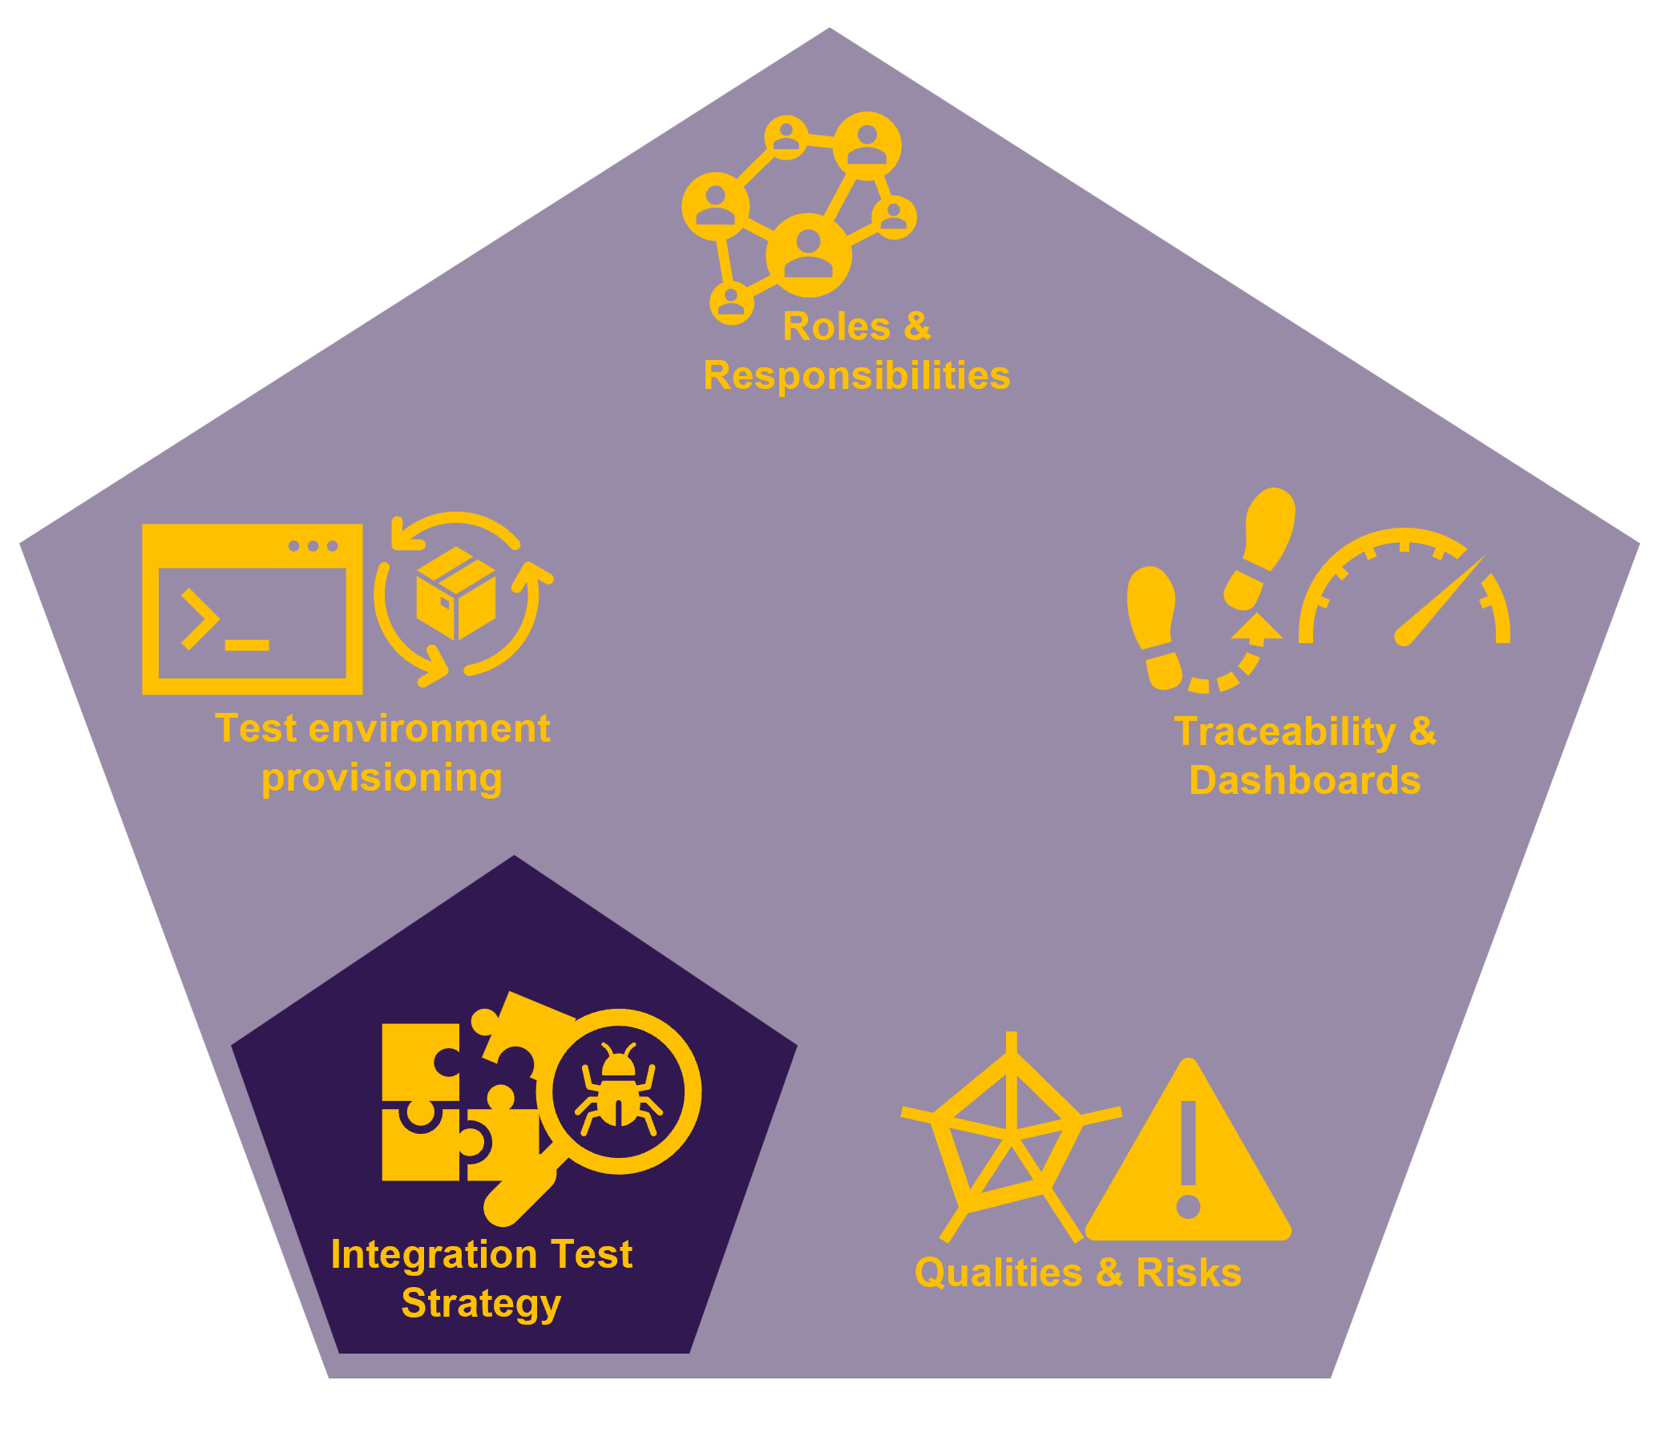
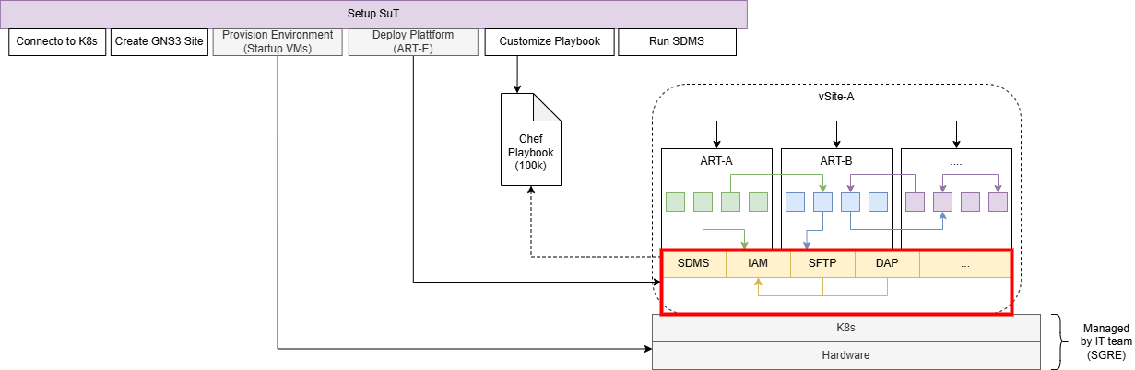
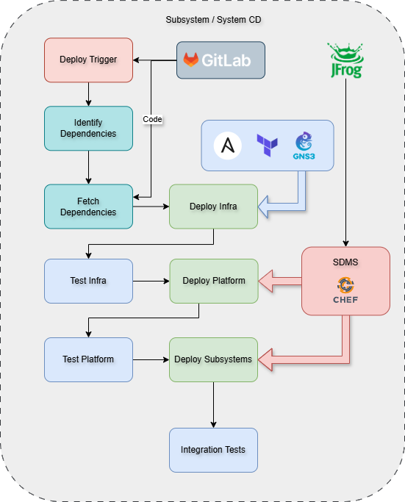
Next Steps - Testing Integration strategy… automated system under test (SuT) provisioning
Automated Provisioning
Setting up a full MySite360 instance includes a total of 47 VMs with hard constrains like static IPs and Ports
Huge amount of different provisioning tooling is used including MySite360 self developed helpers: K8s-clusters, Ansible, Chef, Terraform, GNS3, SDMS, DT
MySite360 using both virtual and physical testing sites.
Currently, manual environment preparation takes up to 2 weeks.
Proposal is to prepare a Golden-system. Install on top your component/application.
Improve Testability (e.g. injection points, data access) linked with the architecture
ART-E Platform + Infra

Slide 7
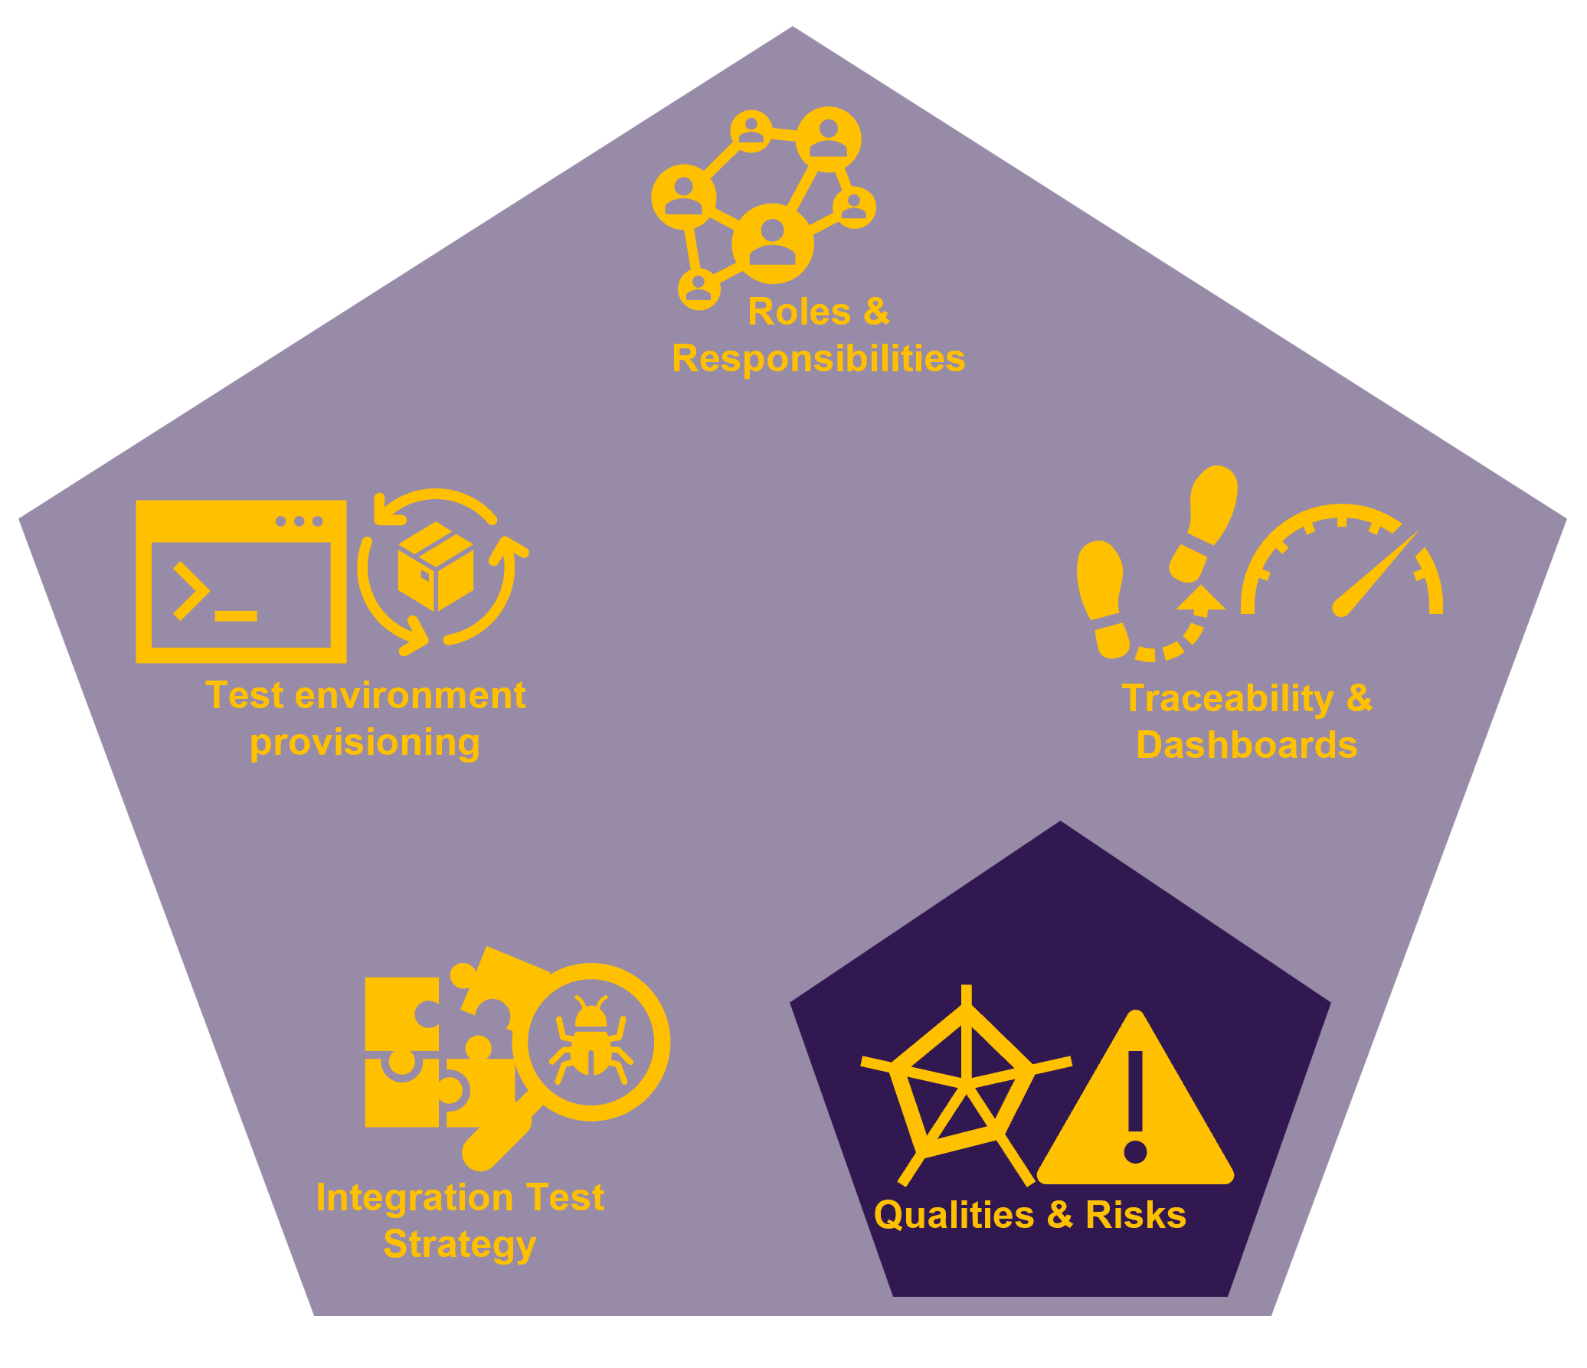
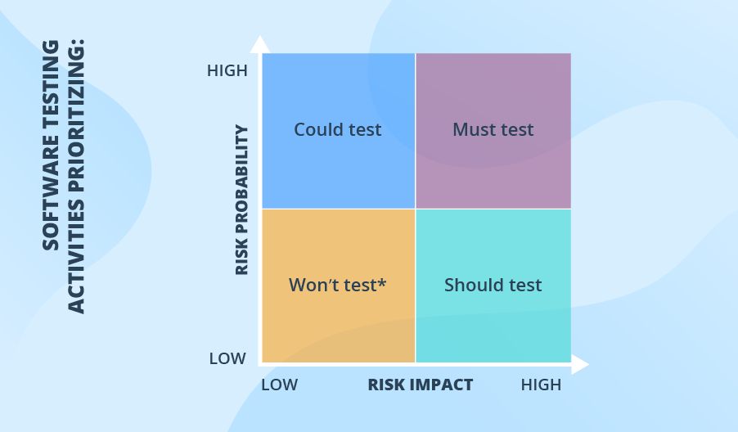
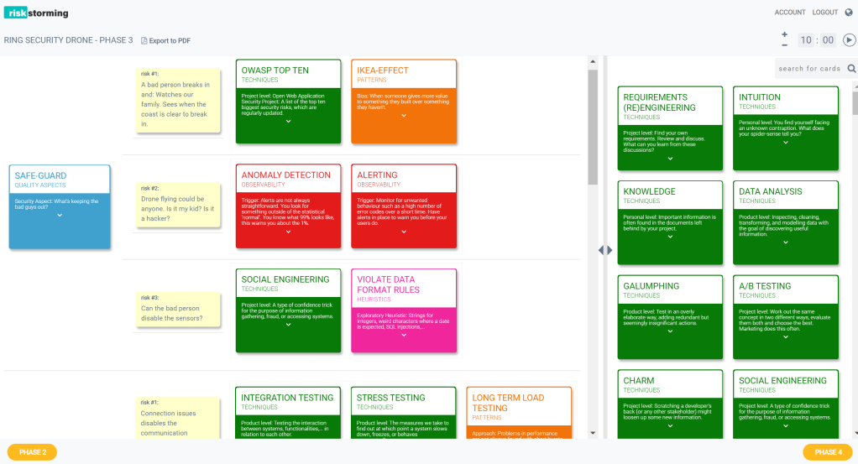
Next Steps – Testing Quality Attributes … NFRs and Risk-Based Testing
Risk-Based Testing of NFRs
Identify the most relevant Quality Attributes (NFRs) for the system and for each component.
Keep in focus business relevance and customer expectations.
As reference use the FURPS model and adapt to your specific needs(*). *FURPS: Functionality, Usability, Reliability, Performance, *Security.
Prioritize of these quality attributes inside the different teams and foster alignment on those topics.
Apply Risk-Based Testing techniques to organize systematically the approach. (e.g. Risk-Storming) and be more efficient by focusing on the most relevant areas.
* Note: images from https://riskstormingonline.com/products/
https://www.scnsoft.com/software-testing/risk-based-testing

Slide 8
Next Steps – Testing Quality Attributes … Requirement Engineering
Requirements engineering
Requirements are an essential input for testing.
Requirements needs to be documented with high quality following DoD including clear formulated acceptance criteria, that allows the definition of test cases.
Carefully manage the link between customer requirement and Development requirement. Assure the proper split and continuous tracing.
Link between feature with test should be
Long time traceability. Also after new releases. Links and tracing should still be

Slide 9
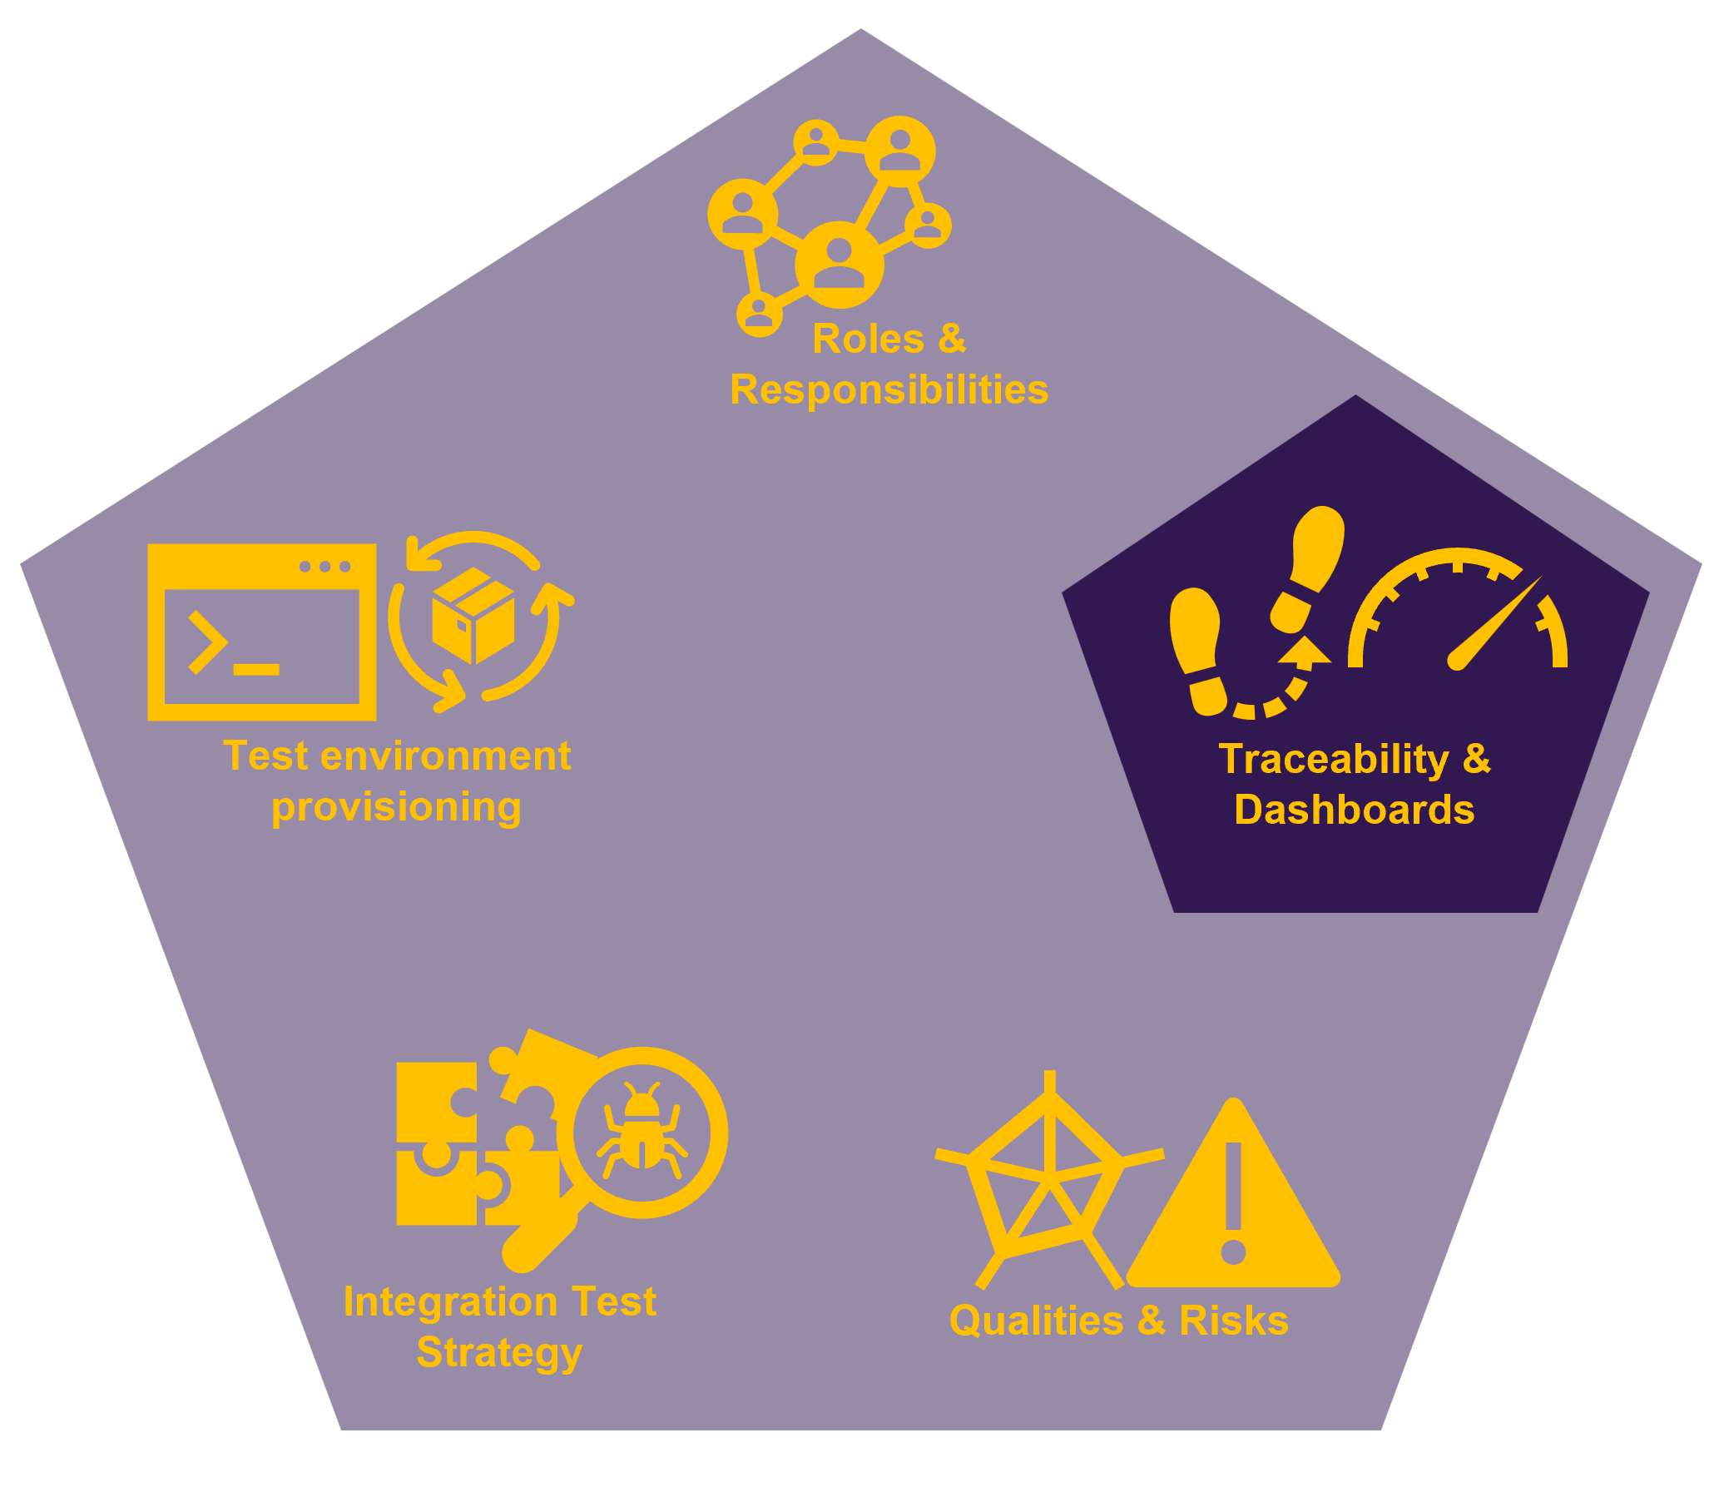
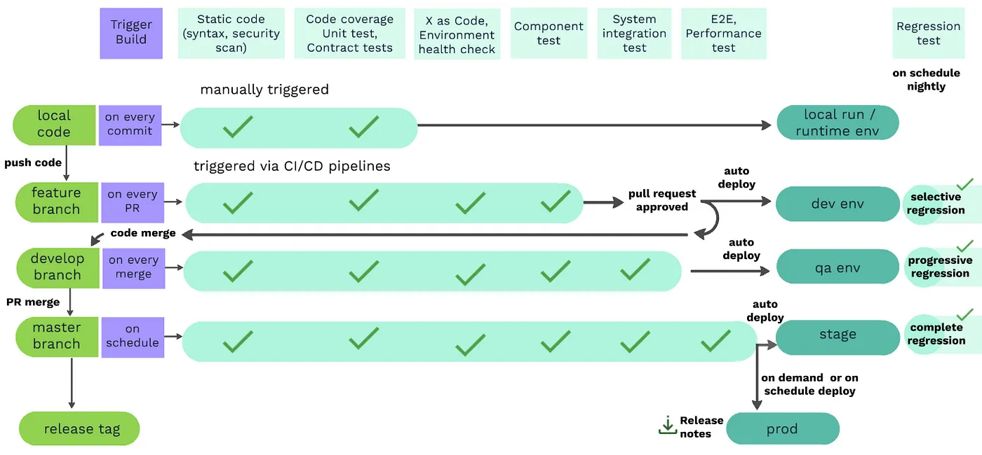
Next Steps – Testing Traceability… Quality Gates
Quality Gates
Introduce Quality Gates into the build and testing pipelines along the entire development & test cycle (dev ARTs A-E, SOLST)
Define hard (i.e. blocking) and soft quality gates
Define coverage goals for all quality gates
Collect the metrics for the defined Quality Gates
Use SonarQube for code-level metrics, e.g. code coverage
Deploy API coverage metrics at component level
Utilize requirement coverage at later test stages
Constantly monitor the metrics and adjust the goals
Ref.: Lesia Topol, Quality gates and Test orchestration strategy in one slide

Slide 10
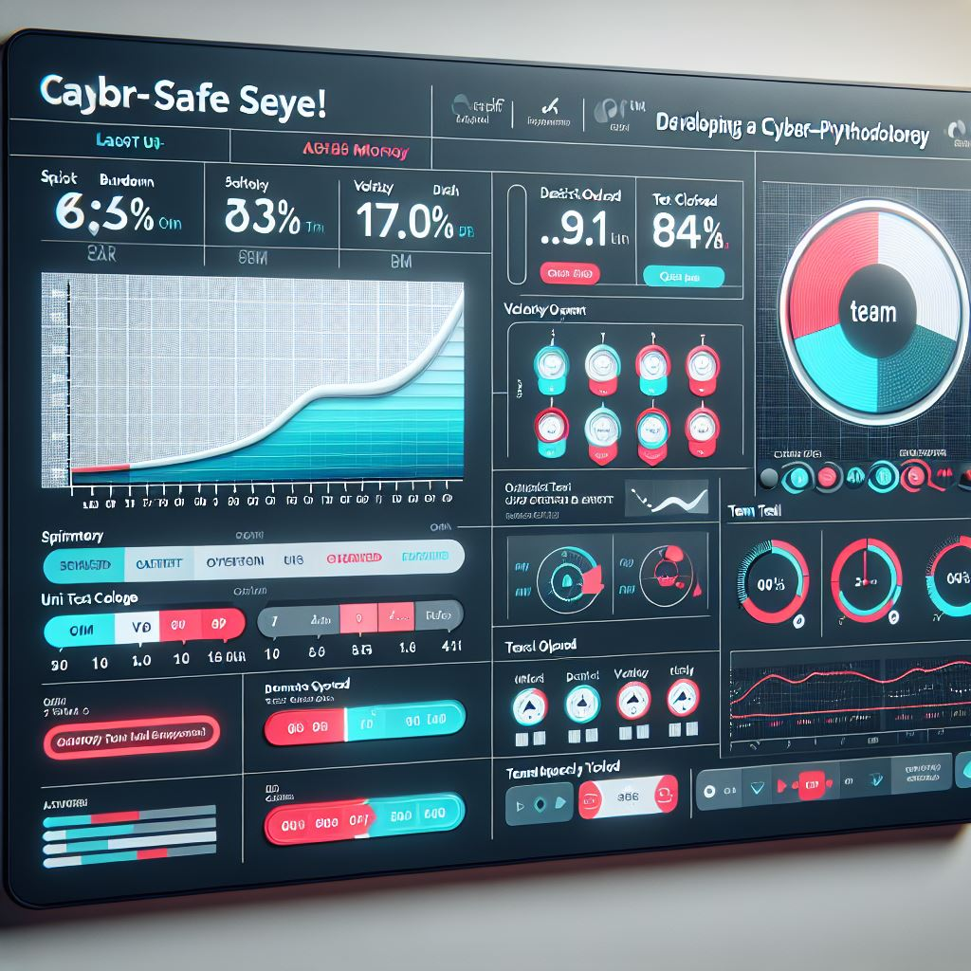
Next Steps – Testing Traceability… KPIs and Dashboards
KPIs and Dashboards
Collect the KPIs for the defined Quality Gates
Introduce Dashboards visualizing the progress in the undertaking in a transparent way
Team level: focus on sprint execution, component quality, team health
ART level: focus on PI progress, feature quality, cross-team coordination
Organization level: focus on strategic alignment, solution quality, business outcome
Define major metrics and ensure that data is collected for calculation and visualization
Illustration with GenAI Copilot

Slide 11
Executive summary

Slide 12
DevOps Pipelines and Testing … executive summary
Analysis
Most MySite360 development teams report the lack of testing possibilities as their biggest pain point
Currently no fully automated test environment provisioning in place. Most test are done at one of the 5 physical sites via manual setup.
First full integration and systems testing happens with a delay of more than 3 month. Basically, while developers start to work on the next PI -- testing teams start to look at the last PI. This leads to a huge delay in feedback and interferes with PI planning.
MySite360 lacks general convenance and each ART have different maturity levels if it comes to testing.
Recom-mendations
It must be possible to spin up a system under test (SuT) on a fully automated way within minutes to enable automated testing.
Focus on stop the bleeding but use commonly accepted DevOps/Testing patterns. The future architecture will heavily impact the way how MySite360 will provisioned/deployed and consequently how test environments are setup. To avoid frustration for developer and testers the general patterns as show on slide 2 will stay the same but for now use the existing tooling for the underlaying technical realization.
Apply governance via a centralized DevOps/Enablement team. This team needs full support from management side and must be empowered to drive the entire DevOps topic. This includes branching- and versioning-strategies, pipeline templates maintenance, infrastructure provisioning and together with testing teams the responsibility over the advances testing pipelines and the final release process.
Decouple “real” on-site provisioning and deployment mechanisms from test infrastructure provisioning during development
Next steps
Restructure and empower DevOps/Enablement team.
Full focus on automated infrastructure provisioning. Adapt the automated provisioning of test infrastructure by the test teams.
Iteratively introduce more test-automation into the provided test infrastructure/environment.
Workshop with all necessary parties, to spread the decisions and technological know-how.

Slide 13
Thank you! Q&A

Slide 14
Backup

Slide 15
SGRE – DevSecOps next Steps - Outlook
Roles & Responsibilities
Roles & Responsibilities
Test environment provisioning
Traceability & Dashboards
Test environment provisioning
Traceability & Dashboards
Integration Test Strategy
Qualities & Risks
Integration Test Strategy
Qualities & Risks

Slide 16
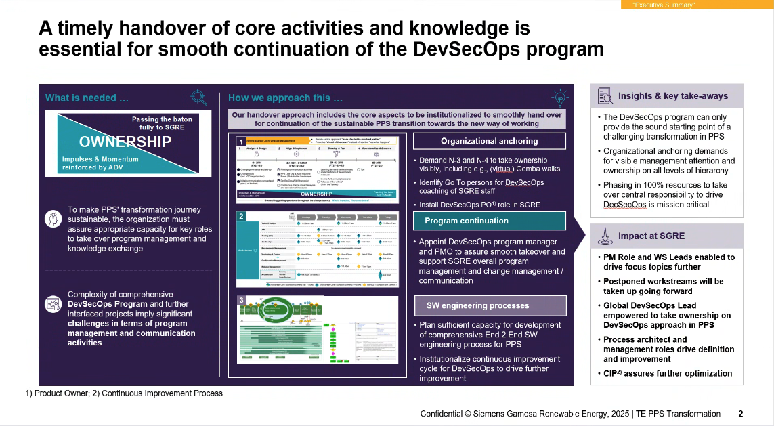
Template…

Slide 17
DevOps Pipelines and Testing … how it looks today
Release complete after devs “says” it is ok – no evidence
Nobody really knows if different components fit together..
Just happens once every release cycle after “code freeze”. In worst case developer getting feedback from the testing team after more than 3 month!
pSites
As-Is
Each team using their own component pipelines with very different maturity levels. No harmonization at all.
The level of automated testing depends heavily on the dependencies towards other components. E.g., ART-A have less dependencies and created their own infrastructure to enable the development teams to do advanced testing.
Current System/Integration-Testing is decoupled from the actional development teams and basically one PI cycle behind implementation. This leads to very late feedback.
ART-E are tested decoupled…

Slide 18
DevOps Pipelines and Testing … fully automated test execution is key
Add column about automation
Important
vSites
The current detailed realization focusing on stop the bleeding and uses existing MySite360 tooling.
The three focus points are:
Shift-Left: Early test execution to reduce number of finding in later “time-consuming” stages
Fast-Feedback: Provide feedback to developers as fast as possible
Automation: high automation rate is key and includes automated provisioning of test environments
pSites
Make clear an in between step .. Maybe some manual testing

Slide 19
DevOps Pipelines and Testing … automated system under test (SuS) provisioning
ART-E / Platform and Infra
Golden-System
Automated Provisioning
Setting up a full MySite360 instance includes a total of 47VMs with hard constrains like static IPs and Ports
Huge amount of different provisioning tooling is used including MySite360 self developed helpers: K8s-clusters, Ansible, Chef, Terraform, GNS3, SDMS, DT
MySite360 using both virtual and physical testing sites.
Currently, manual environment preparation takes up to 2 weeks.

Slide 20
DevOps Pipelines and Testing … governance and empowerment are crucial
Role of Sol-ST?
Leadership
Value environment and infrastructure as product software
DevOps and Testing experts on Enterprise Architecture level required.
Setup DevOps Enablement Team with clear responsibilities across all ARTs. The team must be empowered to roll out all patterns and concepts towards the team.
Extend current testing team
Leverage development efficiency metrics to constantly track progress and changes e.g., DORA-Metrics
Role of Test-Team
Ops Team (BU Teams)
ART Teams
Teams
ART Teams
DevOps
Enablement Team
Setup dedicated enablement team (~5 FTEs for MySite360)
Responsible for environments and pipeline framework
Interface to operations team (BU) to building trust
Full time to cover all aspects not just pSites
Establish 1-2 Site Reliability Engineer per ART team
Interface to enablement team
Know-how transfer into ART teams
Responsible for team pipelines and green2green approach
ART Teams

Slide 21
DevOps Pipelines and Testing … responsibilities
These centralized testing pipelines are managed by the DevOps and Testing teams. These pipelines are located in separated repositories with restricted write permissions. The pipelines can only be adjusted be authorized persons.
This pipelines getting automatically triggered after a new "ready-for-test" artifact is available in the bin-repository. Only if the pipeline was successful the "ready-for-test" artifact gets promoted to the next stage. This can either be another centralized pipeline or the final release.
Each and every component must have their own pipeline. The responsible component team is in charge of this pipeline and have the freedom to adjust the pipeline to their needs. Nevertheless, the result of this pipeline must be a properly versioned artifact which gets pushed to the central binary repository (artifactory).
The DevOps team supports each component team by provisioning pipeline templates as starting point.

